Slide 1
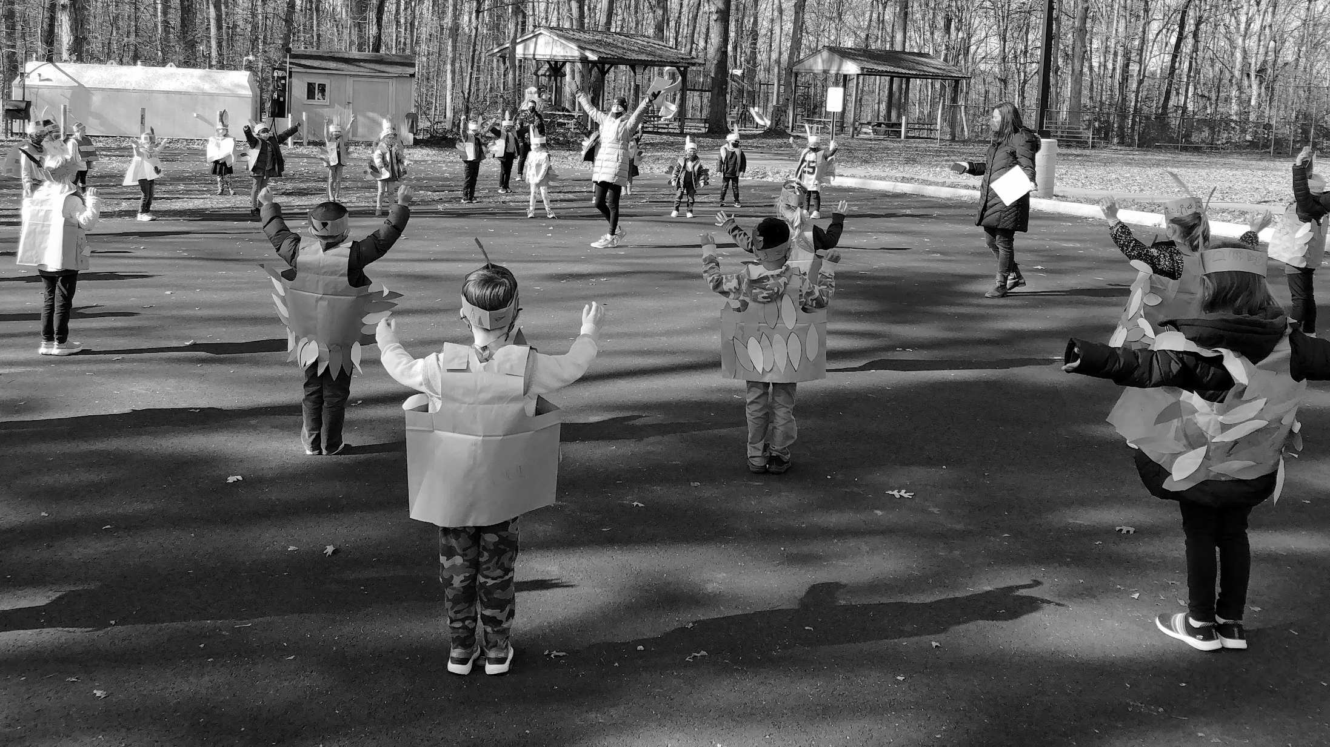

March 23, 2021
STATE OF THE SCHOOLS - Spring 2021 Town Hall

Slide 2
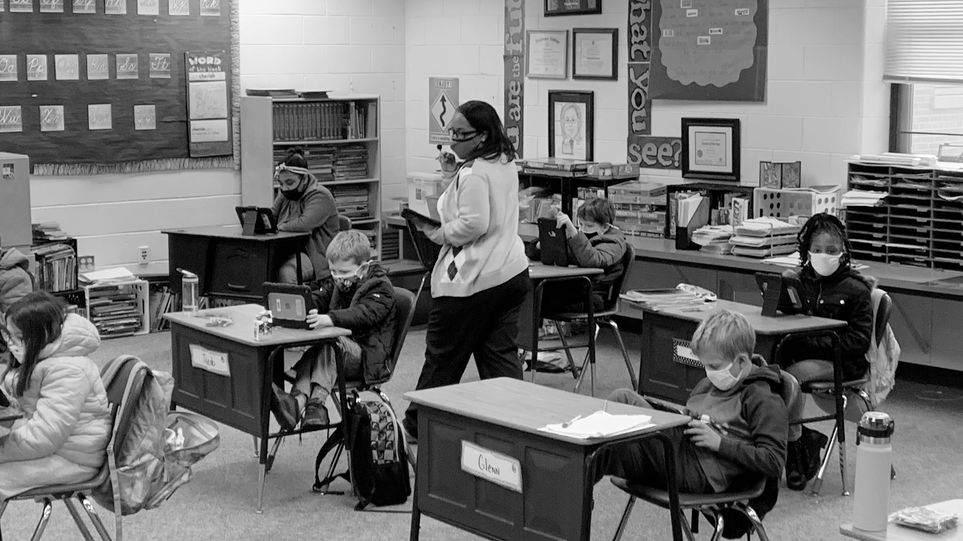

ACCOMPLISHMENTS

Slide 3


Slide 4
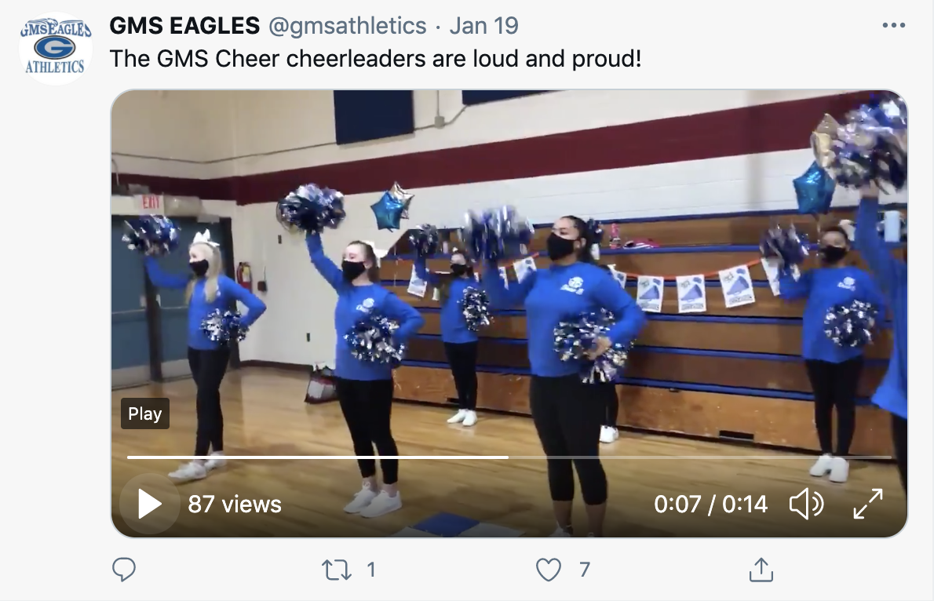

Slide 5
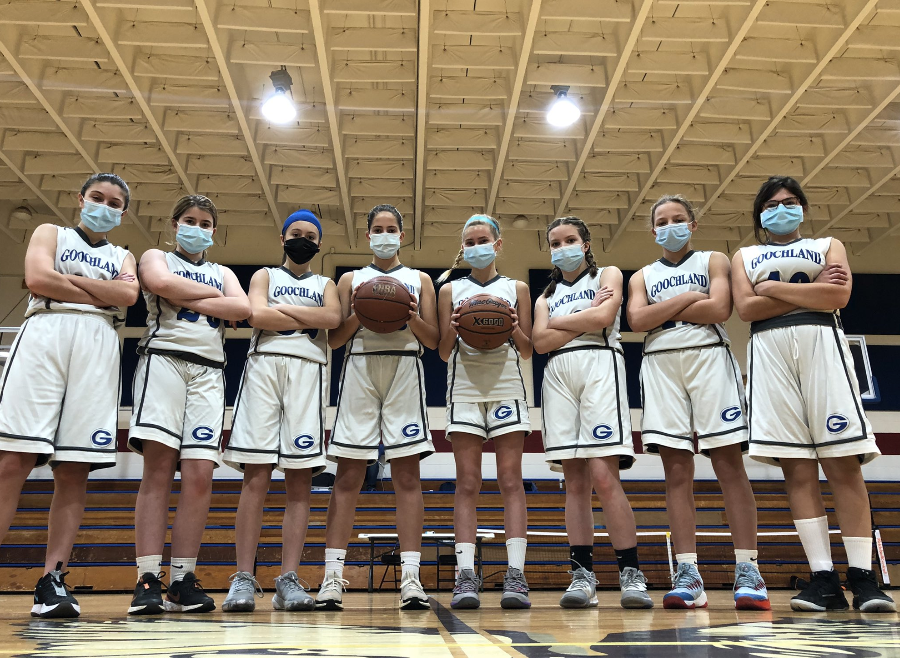

Slide 6
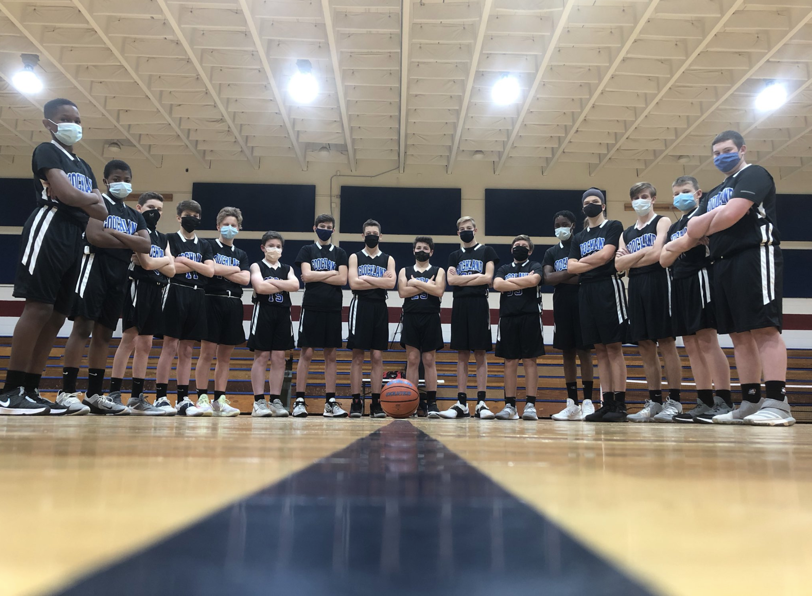

Slide 7
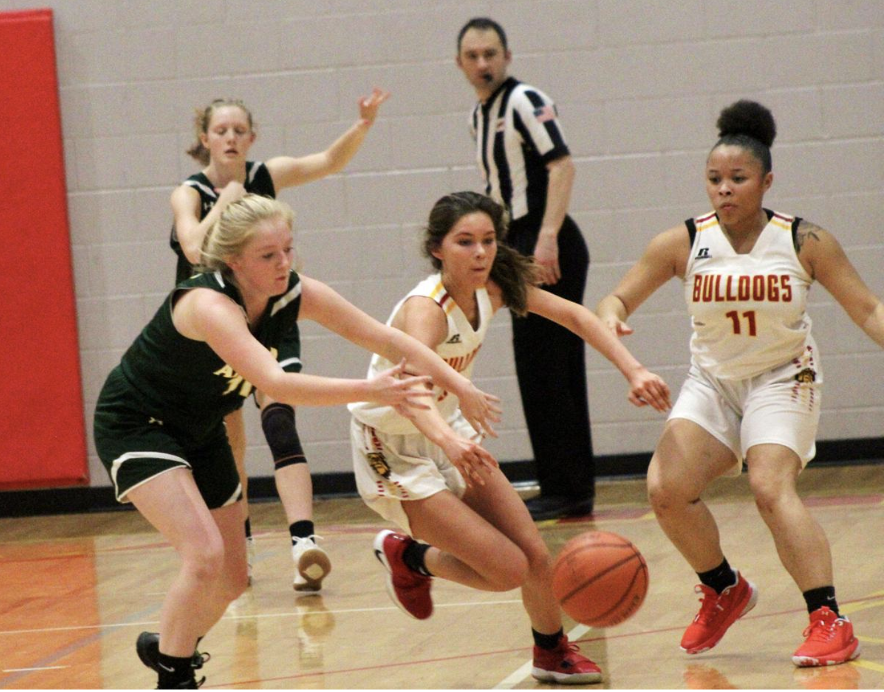

Slide 8
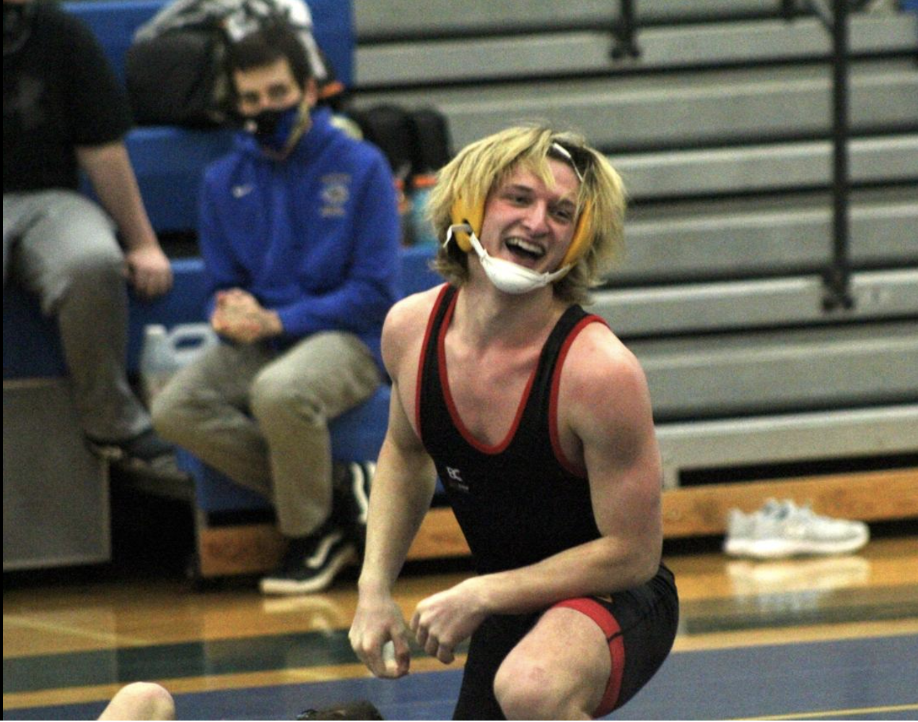

Slide 9
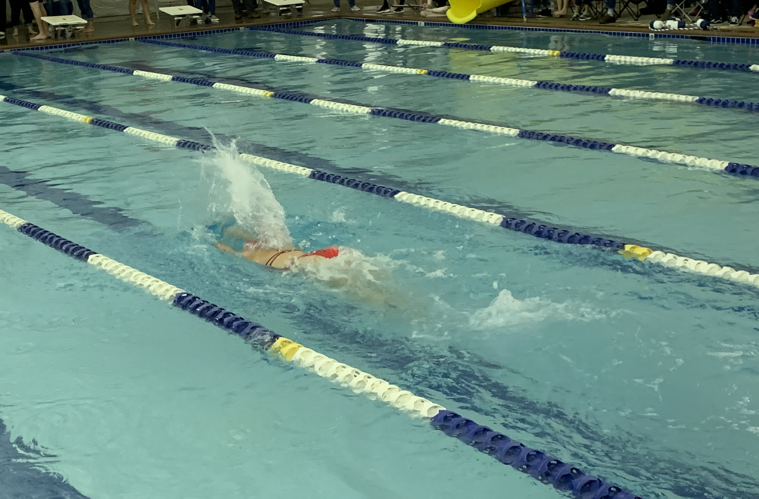

Slide 10
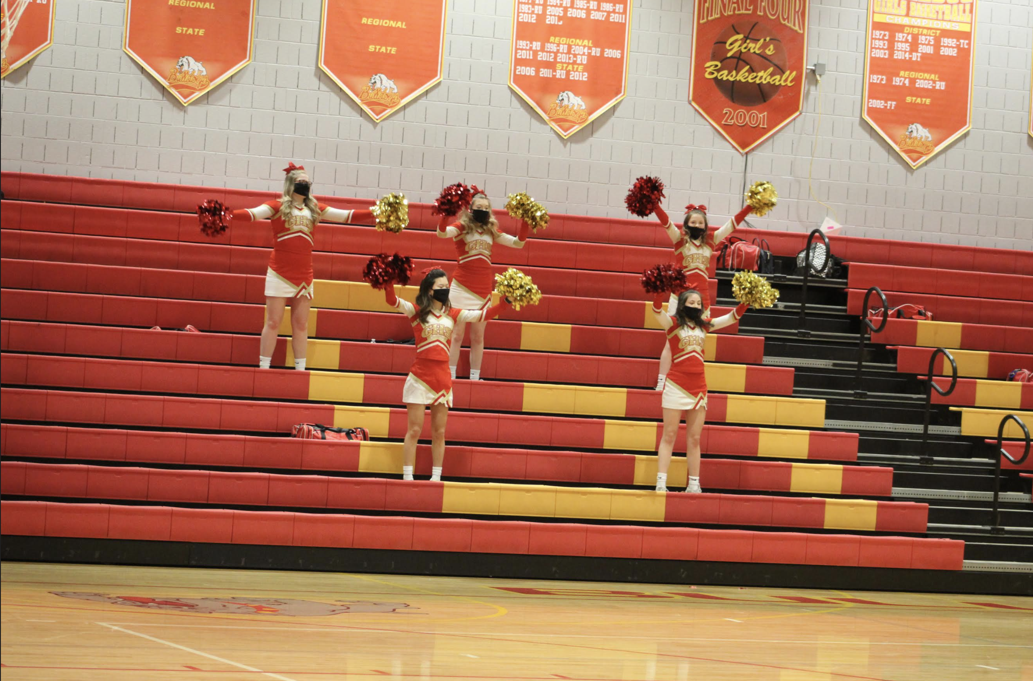

Slide 11
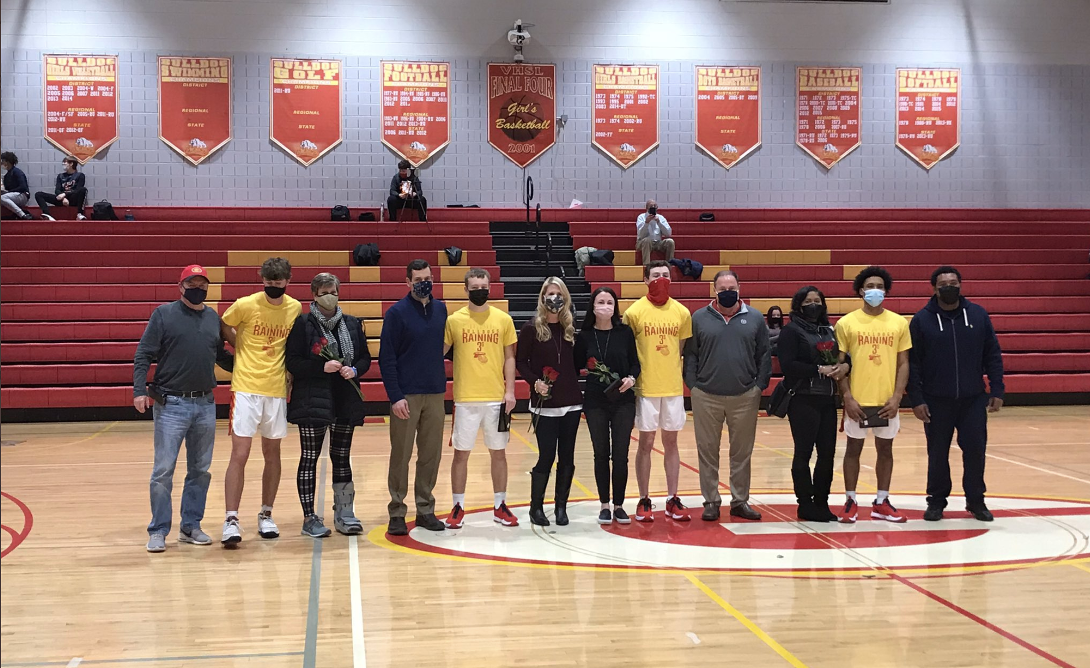

Slide 12
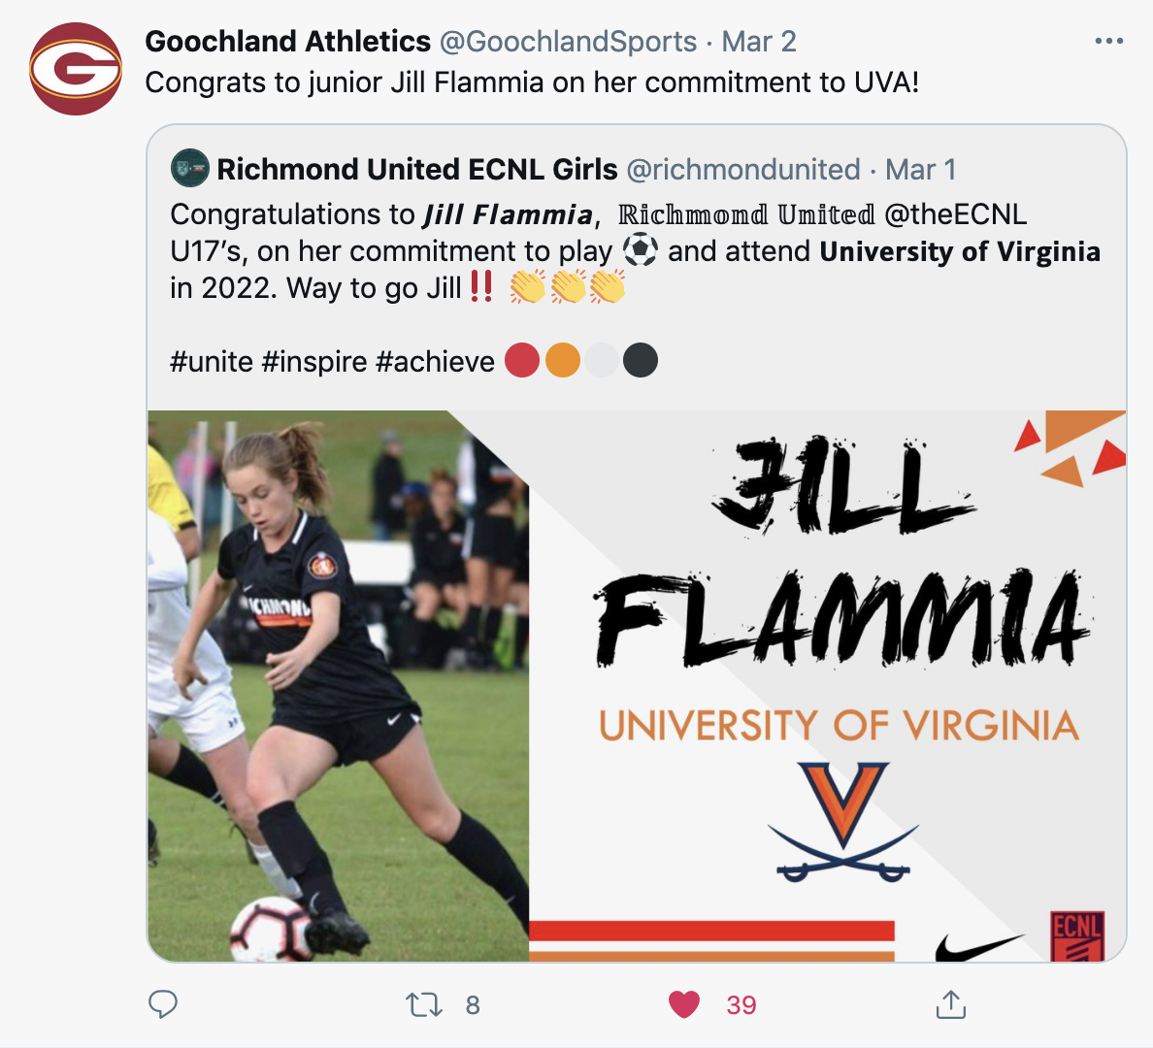

Slide 13
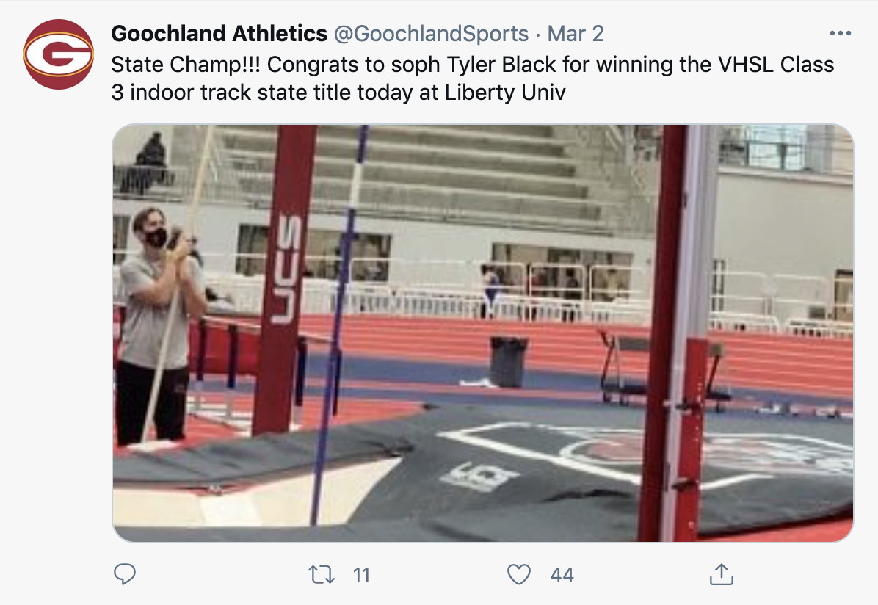

Slide 14


Slide 15

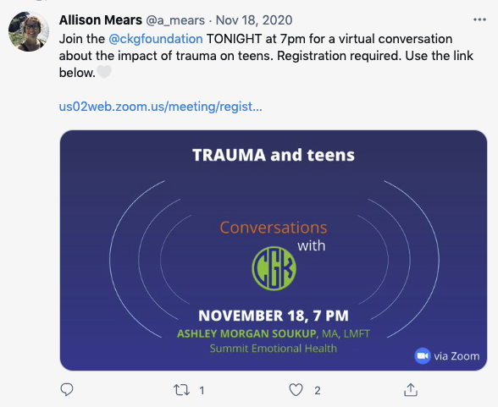


Slide 16

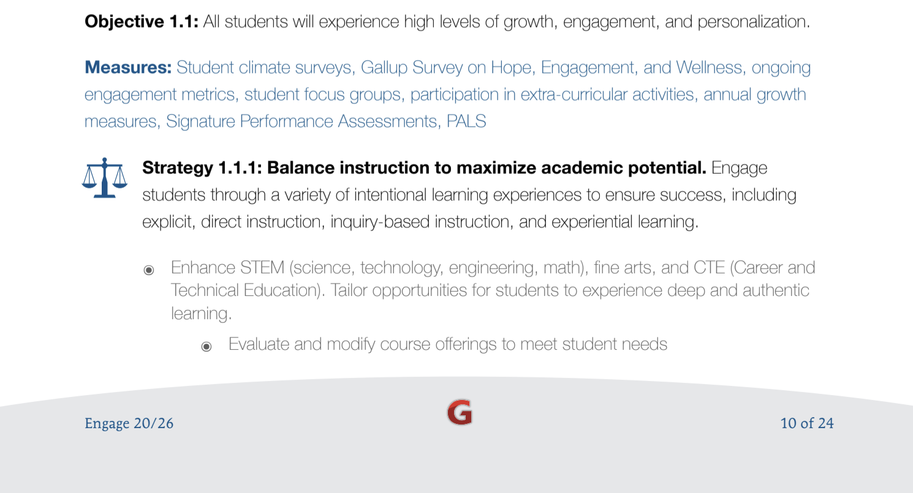

Slide 17

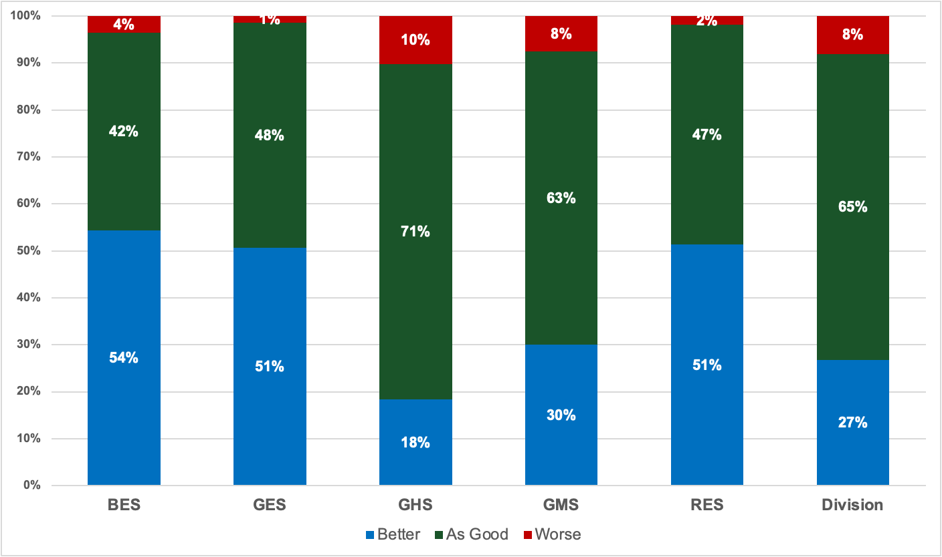
My experience with distance learning or in person learning has been…
(All Responses)

Slide 18
My experience with distance learning or in person learning has been…
(All Responses)
 | BES | GES | RES | GMS | GHS | Division
Late-Sept Survey | 76% | 79% | 84% | 82% | 87% | 82%
Mid-October Survey | 68% | 72% | 76% | 78% | 75% | 74%
Late-October Survey | 91% | 97% | 97% | 87% | 82% | 86%
Late-January Survey | 96% | 99% | 98% | 93% | 90% | 92%
Average of 4 Surveys | 83% | 87% | 89% | 85% | 84% | 84%
Latest Survey v. Average | +13% | +12% | +9% | +8% | +7% | +9%
Percentage of responses reporting a positive experience
(percent of better than expected + percent as good as expected)

Slide 19
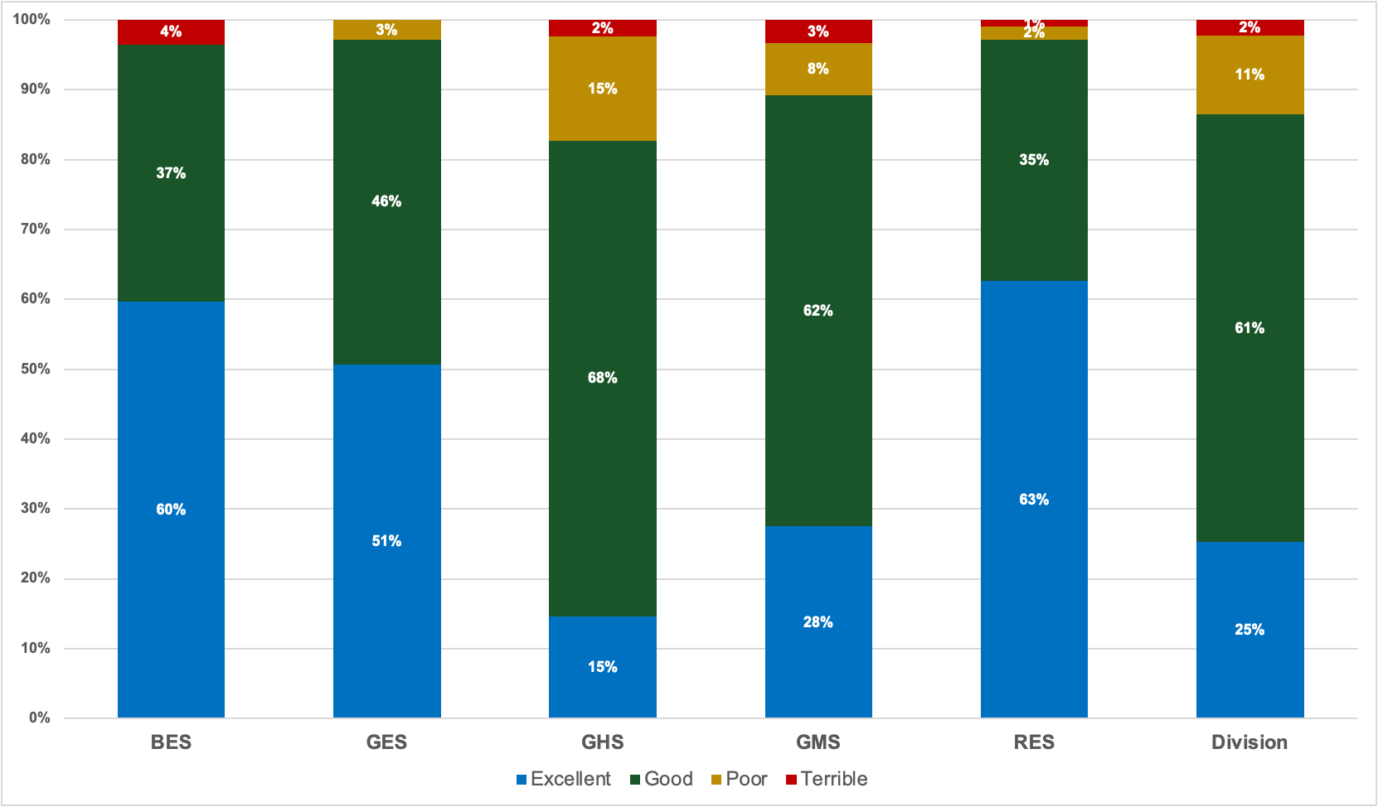
So far, I would rate in person and distance learning as (All Responses)

Slide 20
So far, I would rate in person and distance learning … (All Responses)
 | BES | GES | RES | GMS | GHS | Division
Late-Sept Survey | 70% | 73% | 76% | 74% | 78% | 75%
Mid-October Survey | 63% | 65% | 71% | 70% | 68% | 68%
Late-October Survey | 89% | 93% | 98% | 84% | 75% | 80%
Late-January Survey | 96% | 97% | 97% | 89% | 83% | 86%
Average of 4 Surveys | 80% | 82% | 86% | 79% | 76% | 77%
Latest Survey v. Average | +17% | +15% | +12% | +10% | +7% | +9%
Percentage of responses reporting a positive experience
(percent excellent + percent good)

Slide 21
Health Data

Slide 22


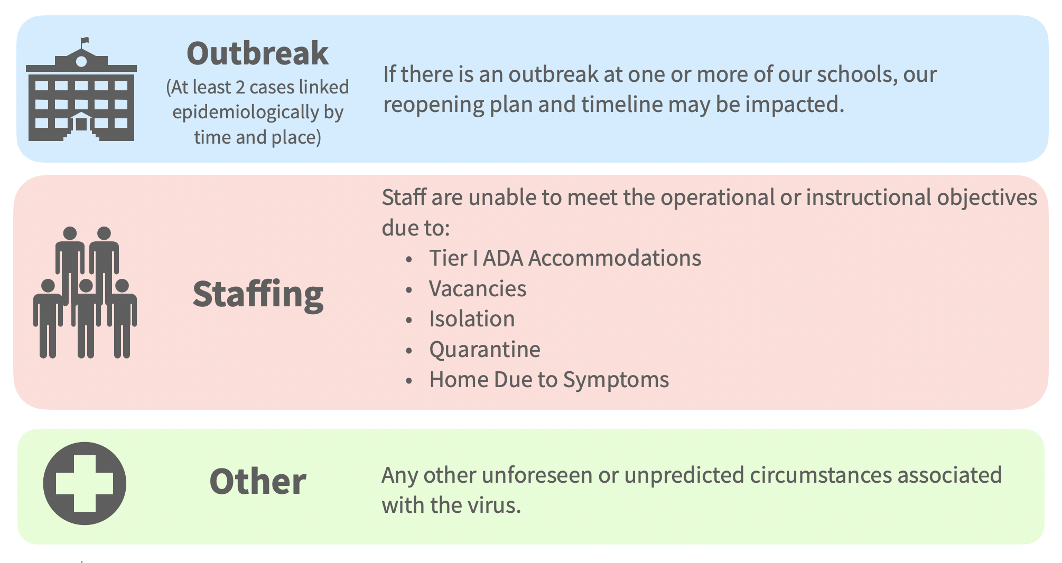
The following variables may impact our school division’s reopening plan:

Slide 23
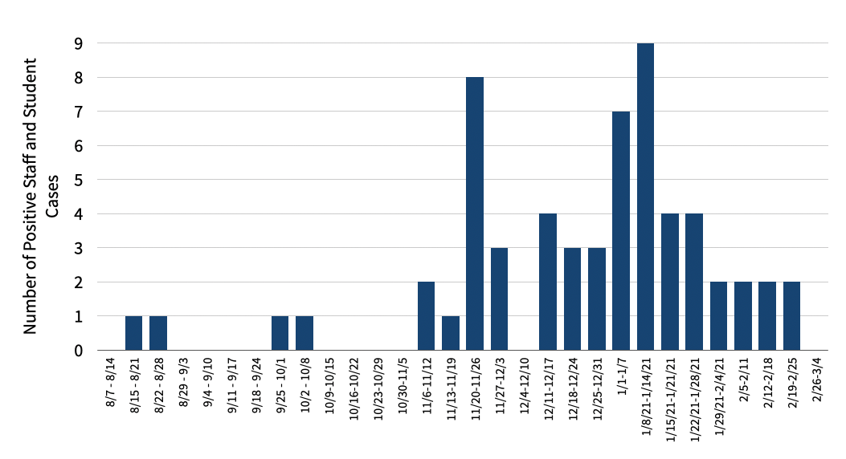
Number of Positive or Probable Student and Staff Cases Per Week

Slide 24
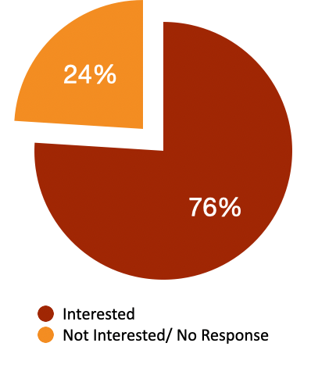
Vaccination Update
76% of GCPS employees expressed interest in receiving the vaccine.
By 3/9/21, 100% of employees who were interested in receiving the vaccine will have received their first dose.
By 3/9/21, 85% of employees who were interested in receiving the vaccine will have received their second dose.
100% of employees will have received both doses of their vaccine by the beginning of April.

Slide 25
Looking Toward the Future

Slide 26
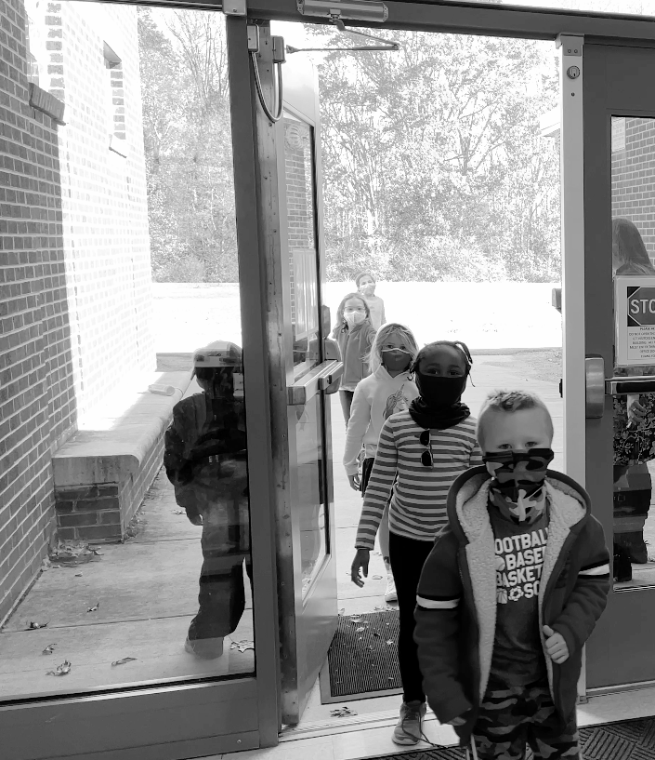
FOCUSING ON WHAT MATTERS MOST

Slide 27
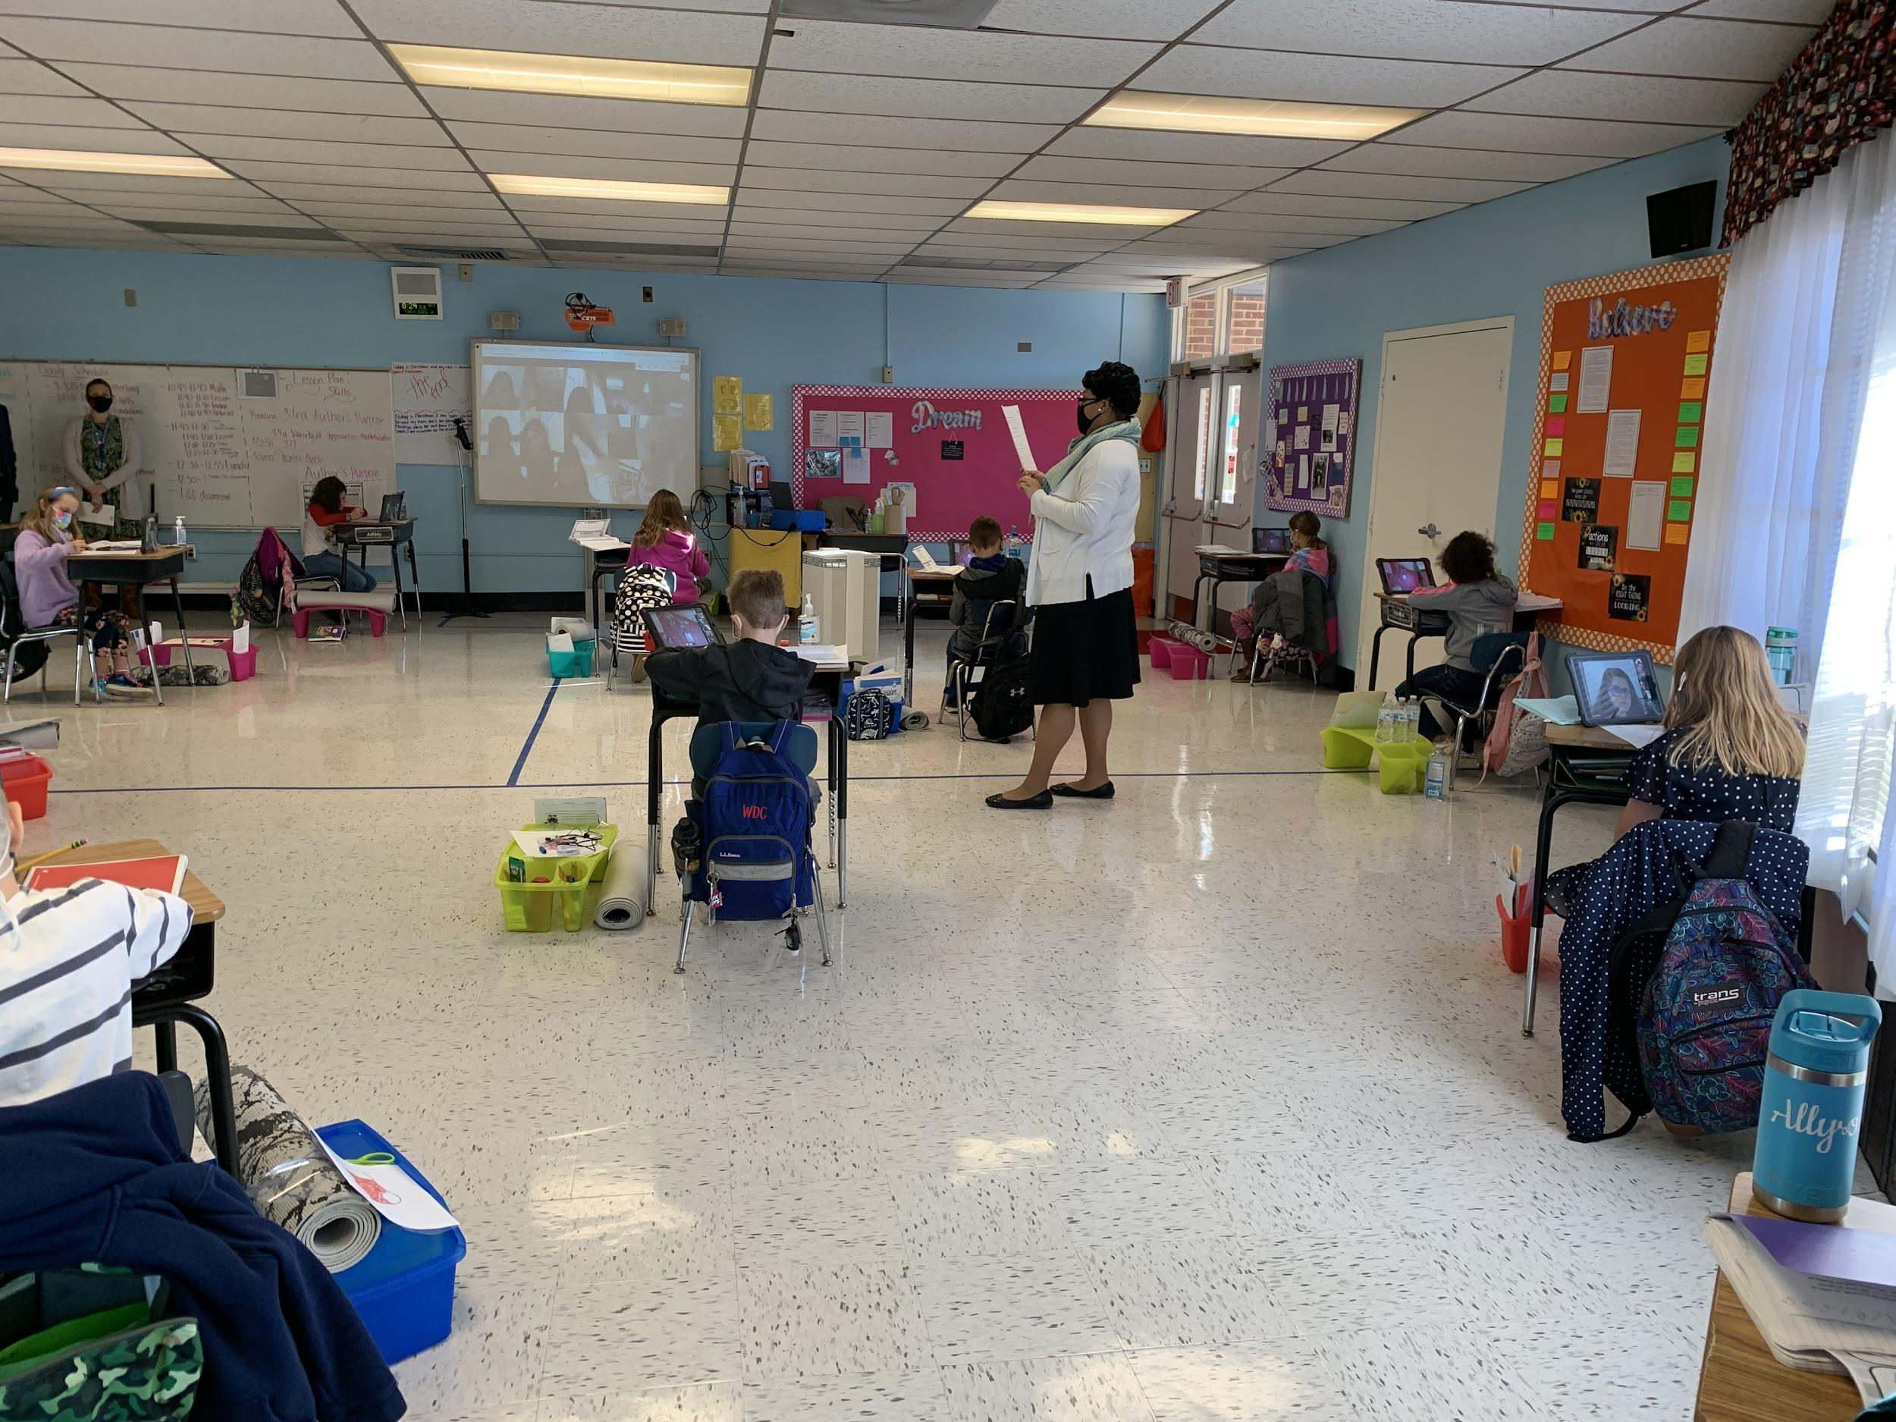
FORECASTING THE FUTURE - IN PERSON 5 DAYS A WEEK

Slide 28

FORECASTING THE FUTURE - CHALLENGE THE TRADITIONS OF TIME

Slide 29
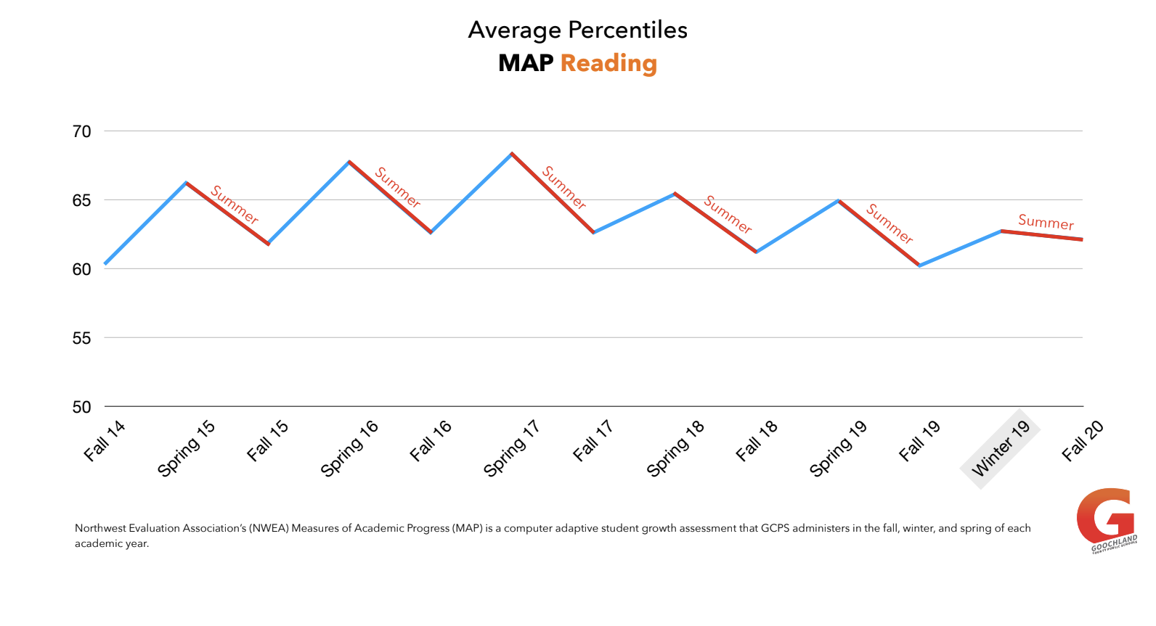
FORECASTING THE FUTURE - CHALLENGE THE TRADITIONS OF TIME

Slide 30
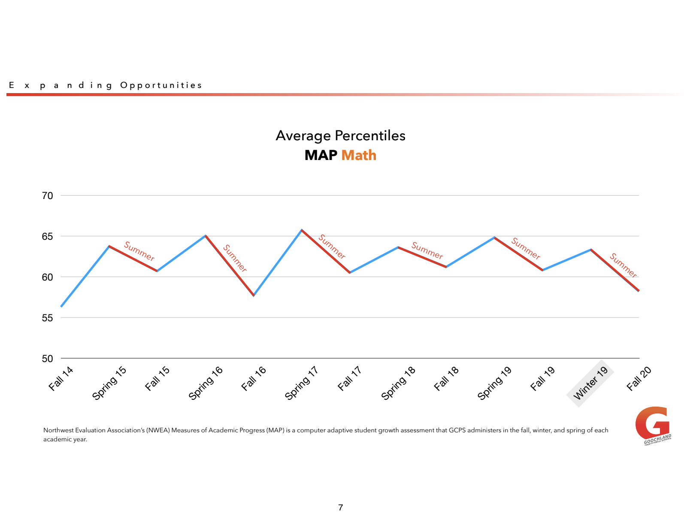
FORECASTING THE FUTURE - CHALLENGE THE TRADITIONS OF TIME

Slide 31
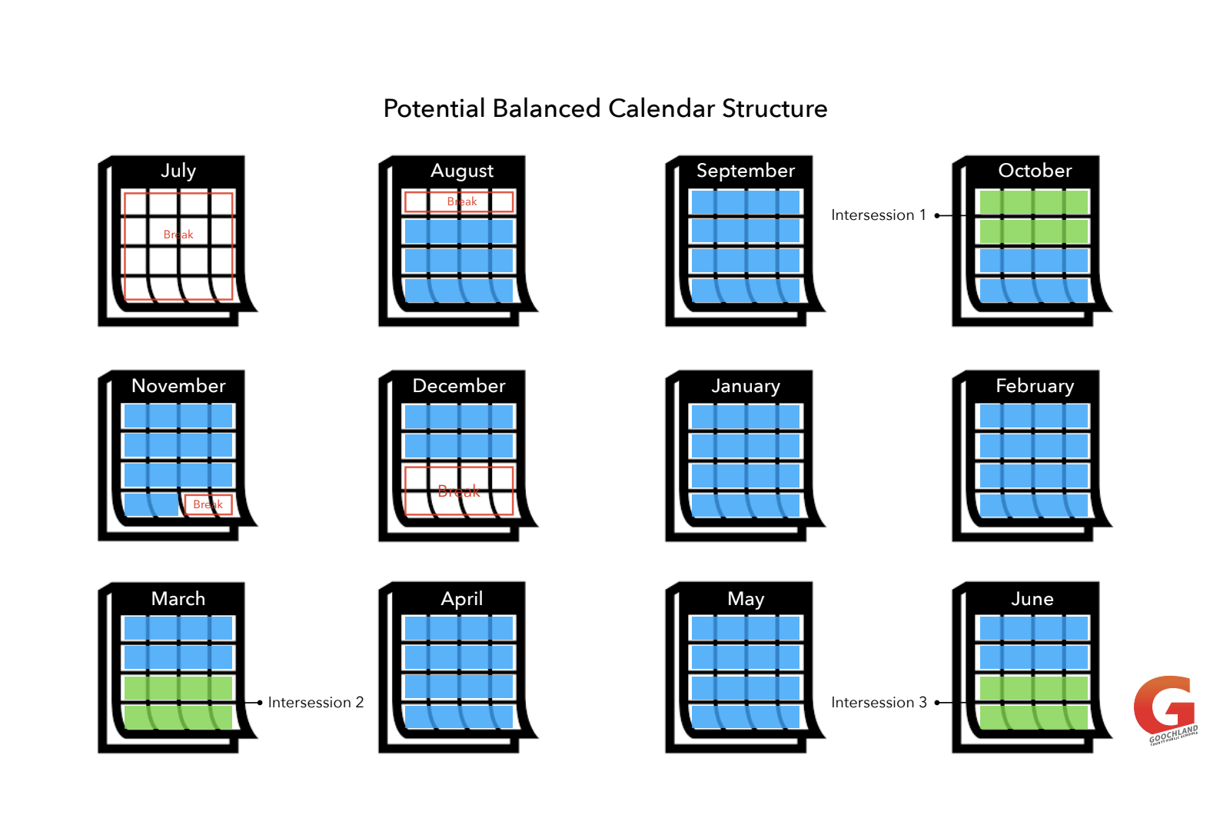
FORECASTING THE FUTURE - CHALLENGE THE TRADITIONS OF TIME

Slide 32
FY 2022 Budget Request

Slide 33
SUMMARY OF AMENDED BUDGET
EXPENDITURES BY FUND
OPERATIONAL | $32,656,576
TEXTBOOK | 268,675
FEDERAL GRANT | 3,383,142
OTHER SPEC. REV. | 248,510
FOOD SERVICES | 1,098,003
TOTAL ALL FUNDS | $37,654,906
REVENUE BY SOURCE
LOCAL TRANSFER | $24,500,000
STATE | 8,140,091
FEDERAL | 3,917,220
OTHER LOCAL | 1,097,595
TOTAL ALL FUNDS | $37,654,906

Slide 34
ADDITIONAL FEDERAL FUNDING (NEW)
American Rescue Plan - potential $2 million extra for GCPS to be used by 9/30/2024
Short term need - more indoor air quality improvements - $650,000 of capital improvements identified to be completed in the next 12 months (GHS cooling tower replacement, upgrade to HVAC in oldest sections of RES/BES), continuing improvement of building automation systems
Funding available as early as June 2021; amend the budget to include $925,000 more for capital maintenance projects and $75,000 for extended summer opportunities for learning loss

Slide 35
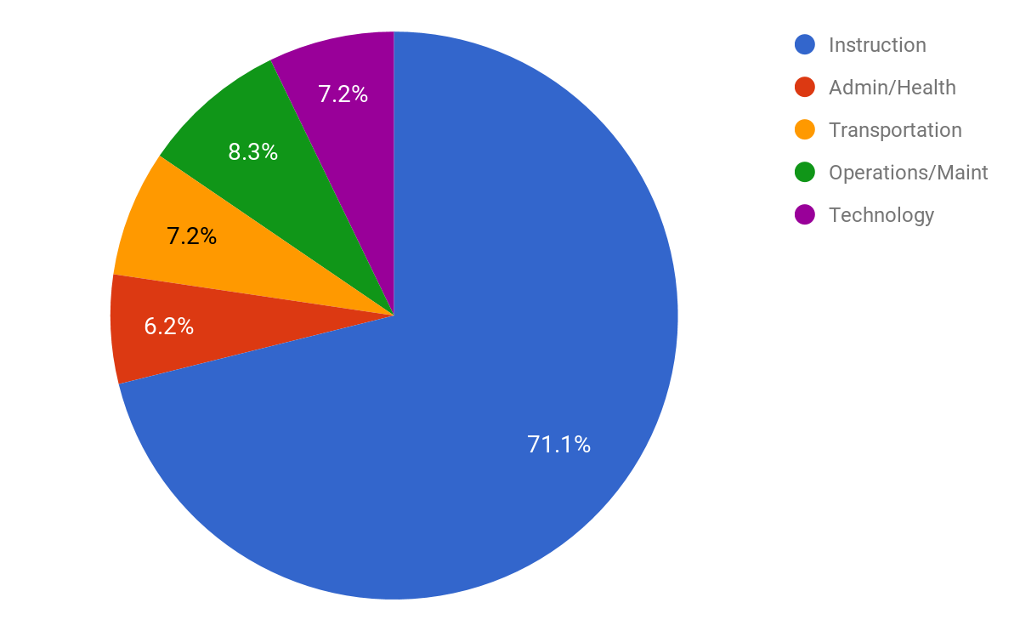
Proposed GCPS FY2022 Budget Investments (By State Category)
Minor changes from the Amended FY 2021 budgeted expenditure percentages (instruction down by 0.25%, transportation up 0.11% and operations/maintenance up 0.14%)

Slide 36
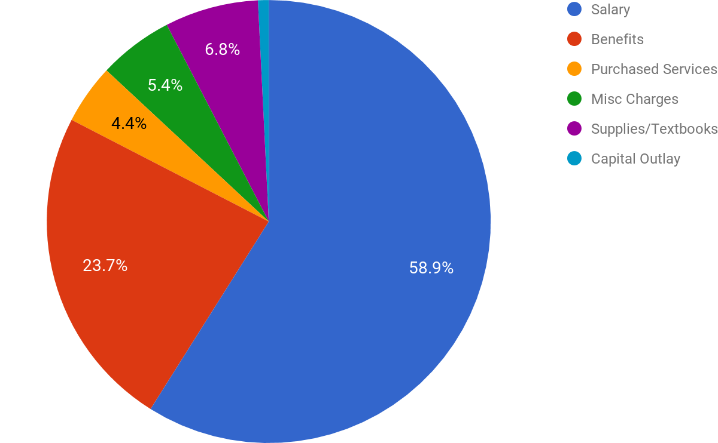
Proposed GCPS FY2022 Budget Investments (By Type of Expense)
Percentages are similar to the Amended FY 2021 budgeted expenditure percentages (salary down 0.3%, supplies down 0.4% while purchased services & capital outlay are up 0.4 and 0.3%, respectively )

Slide 37

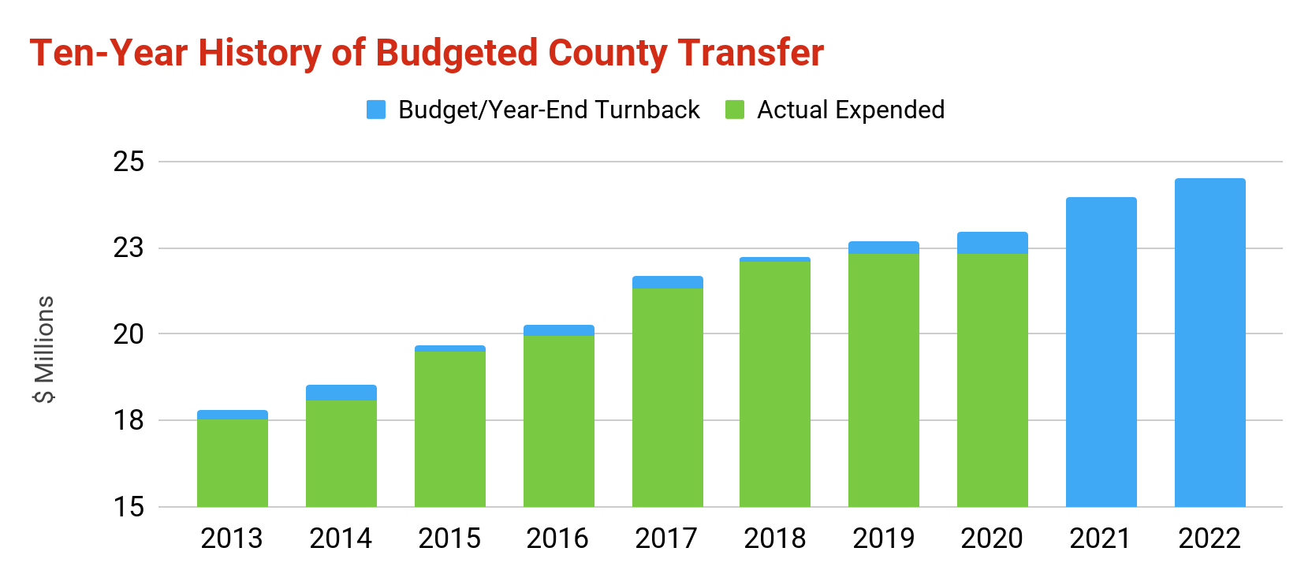
2021-2022 Revenue: County Transfer
Additional funding from County: $1,170,000 for a total $24,500,000
New Money
(Year over Year, in Thousands)
$1,347
$800
$900
$670
$760
$740
$0
$1,170

Slide 38
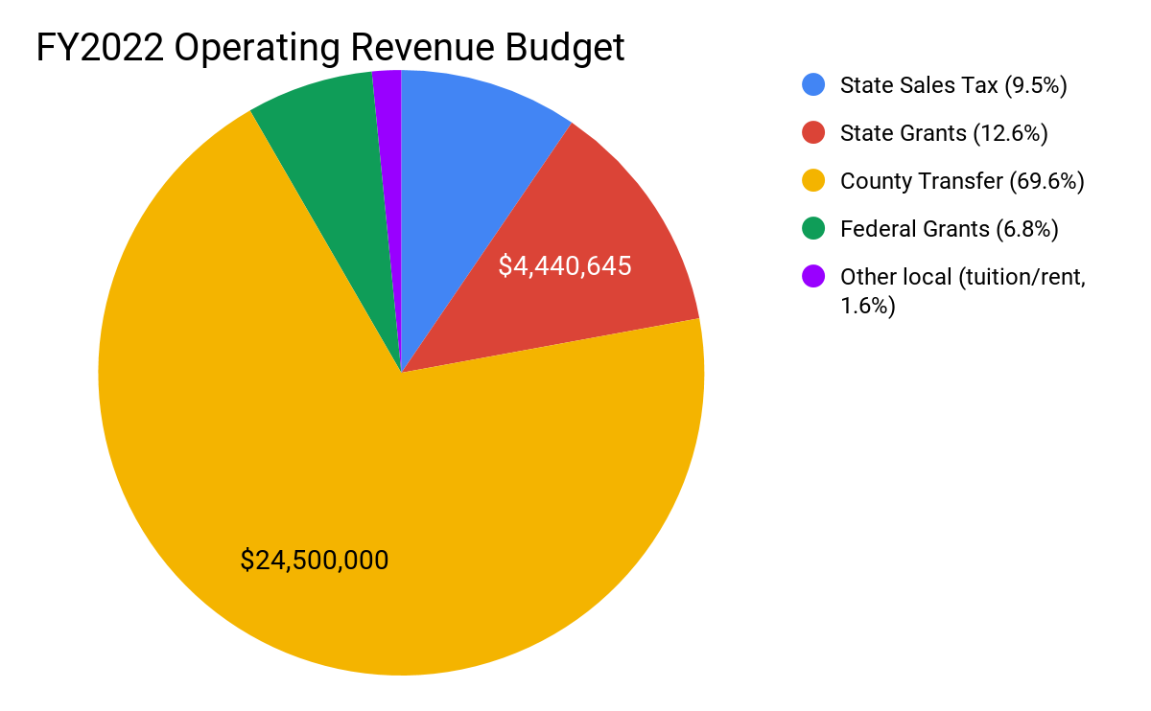
2021-2022 Projected Revenue
Federal revenue higher compared to the FY 2021 amended budget (68%)

Slide 39
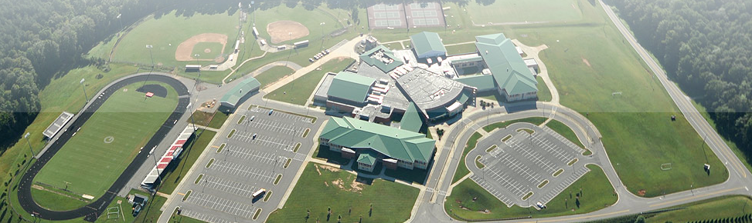
Capital Improvement Needs

Slide 40
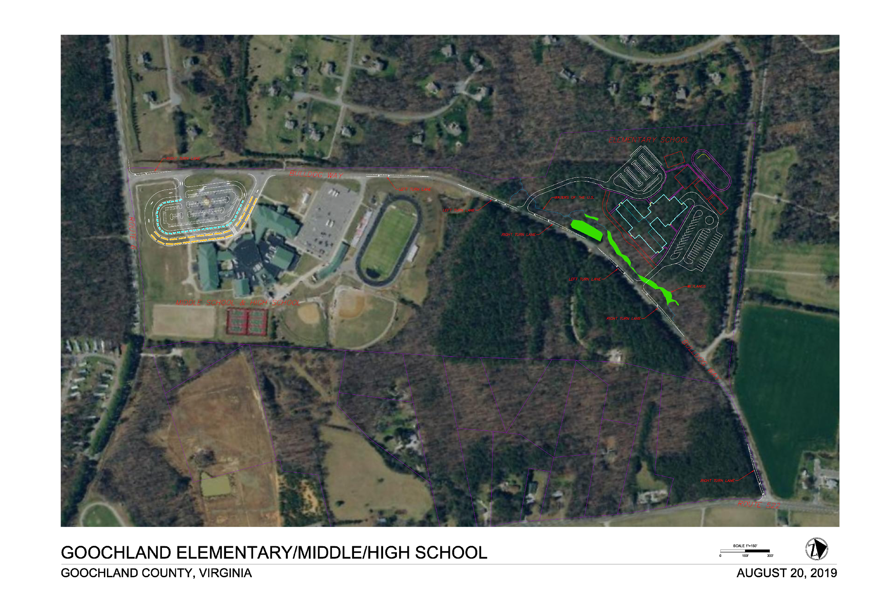

Slide 41
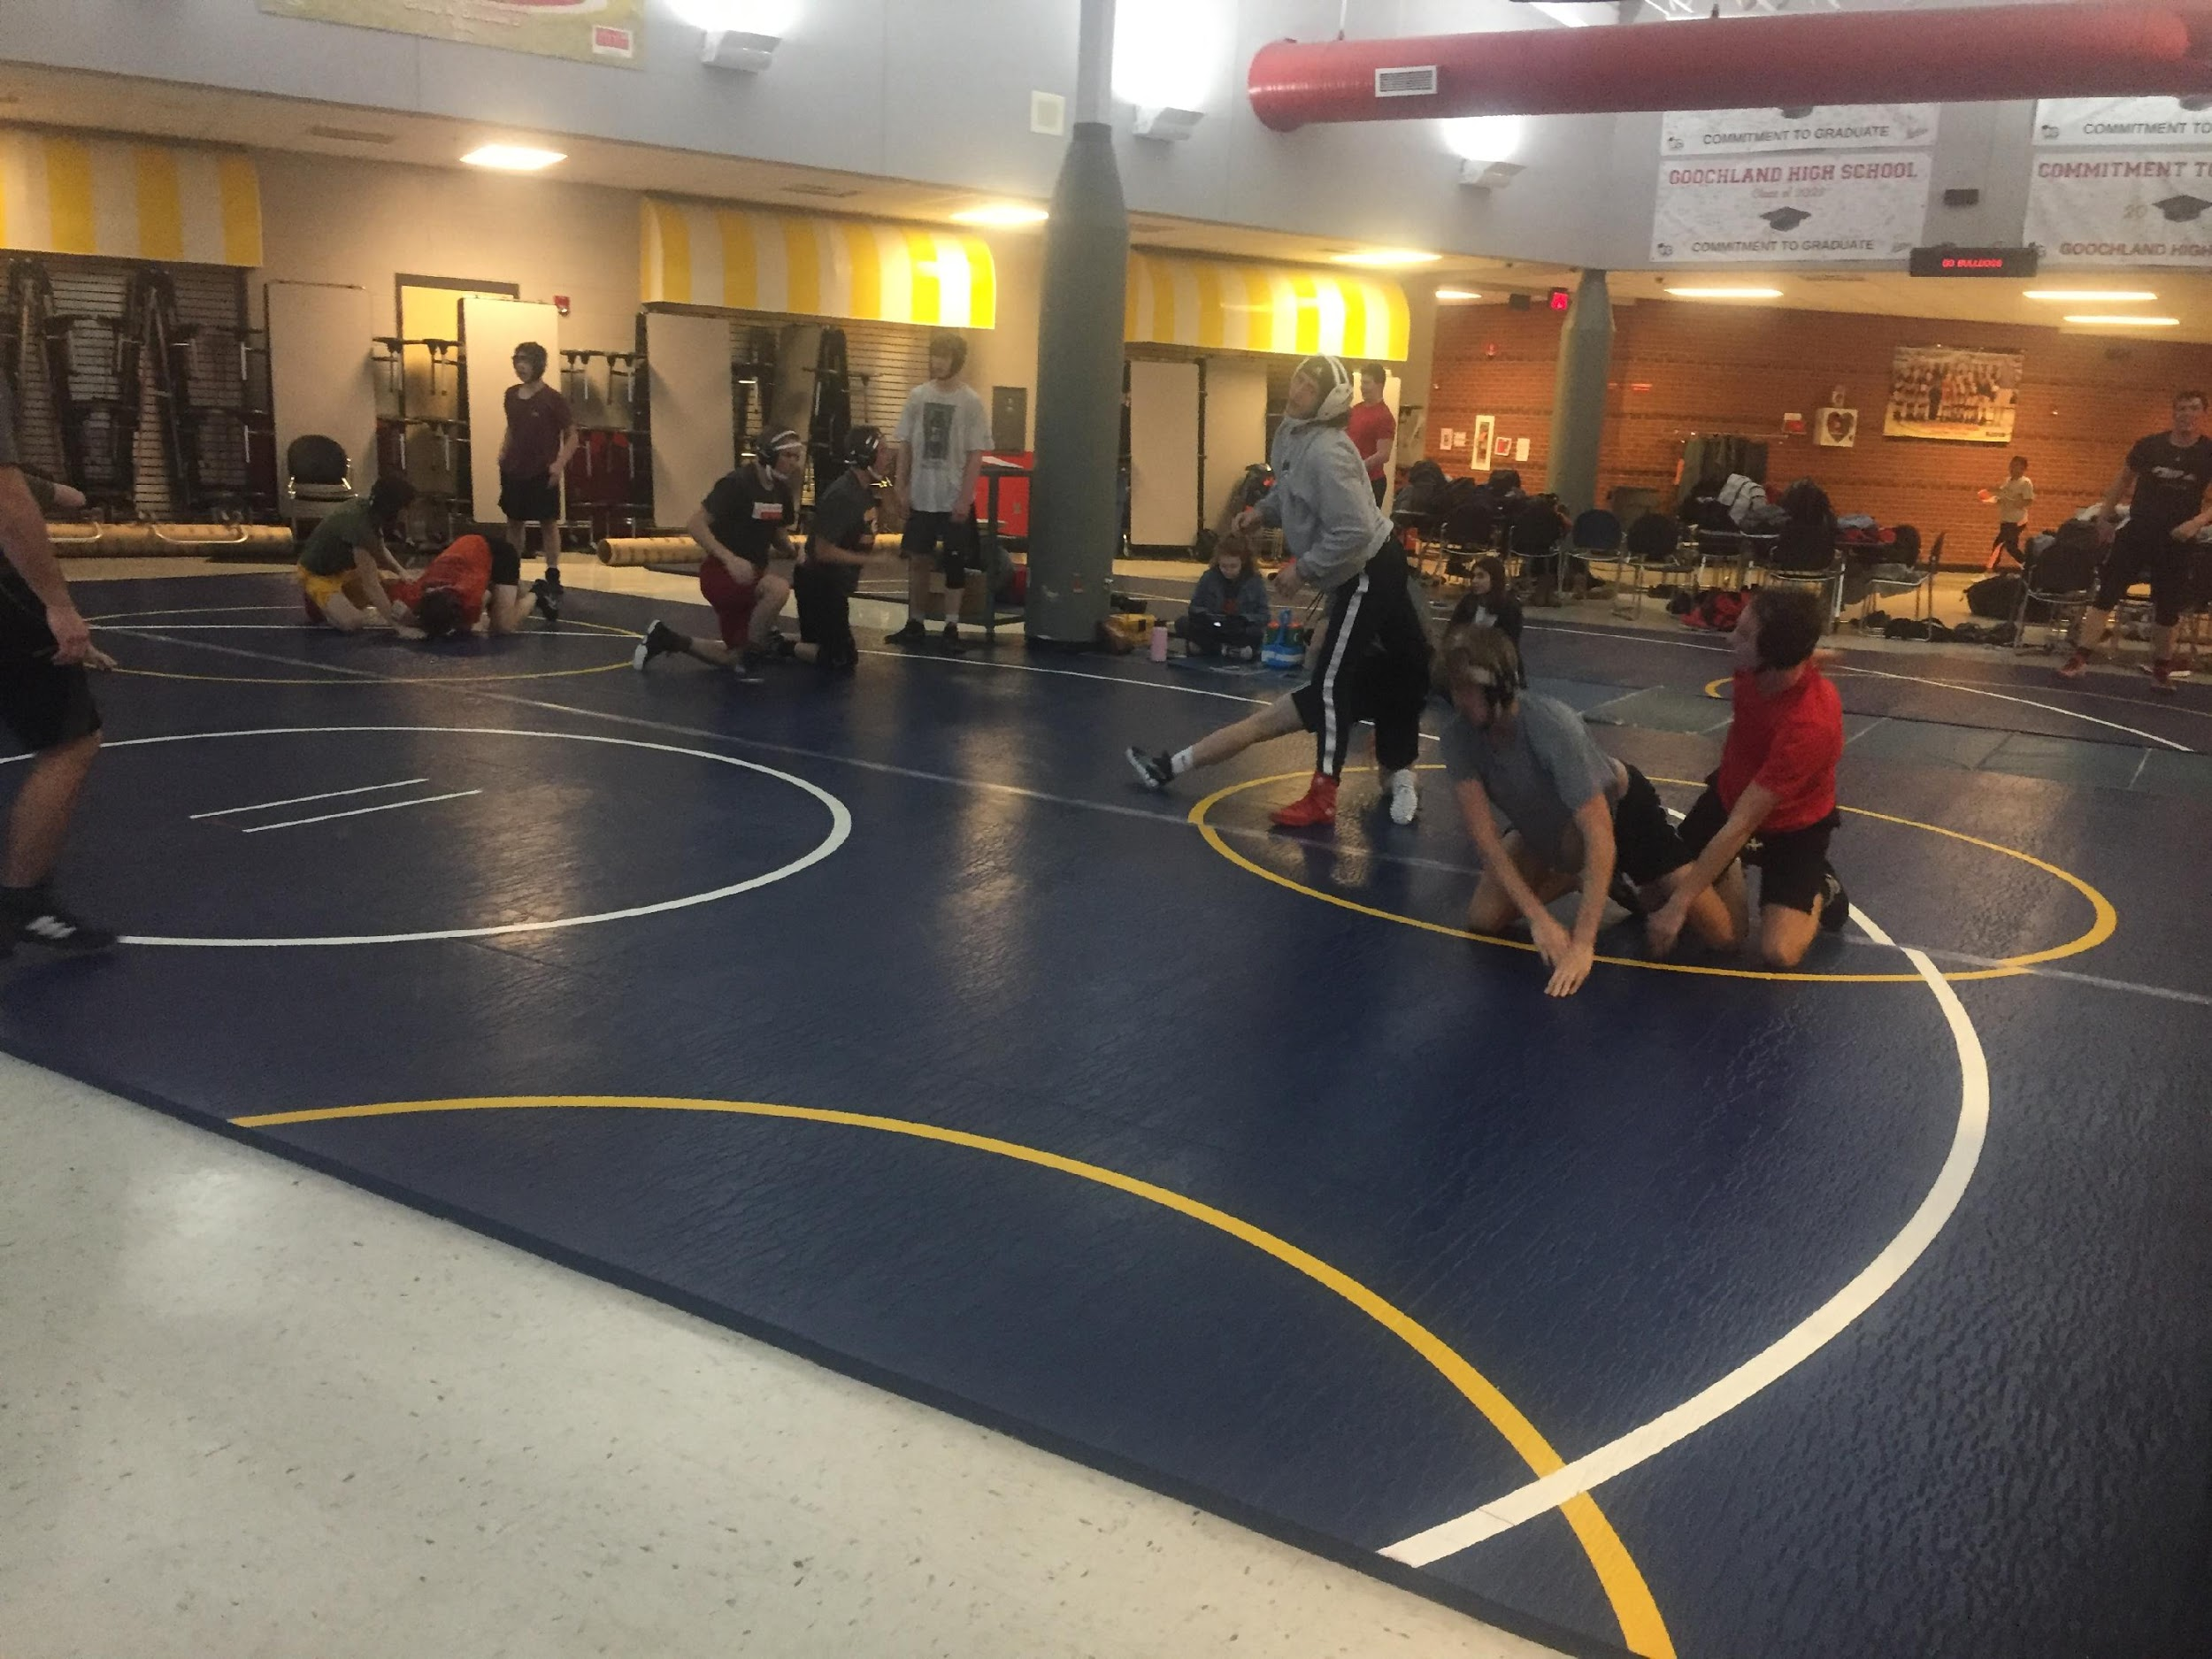
GHS is 1 of only 3 schools out of 12 in Region 3B without an auxiliary gym

Slide 42

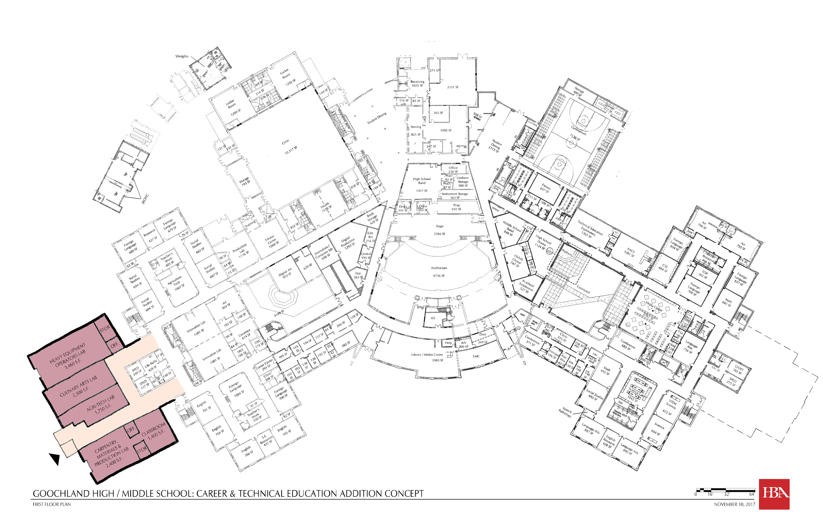

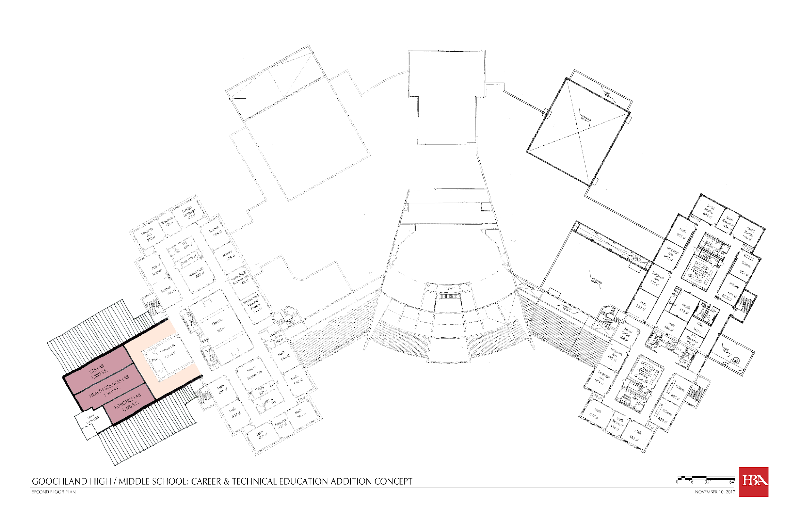

Slide 43
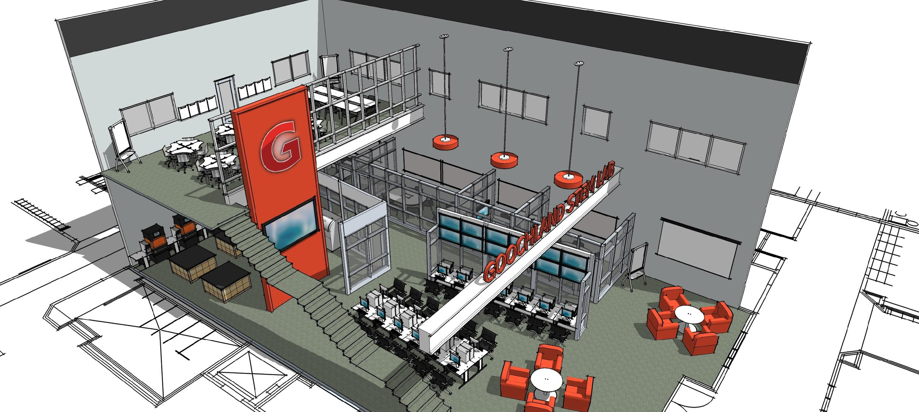

Slide 44
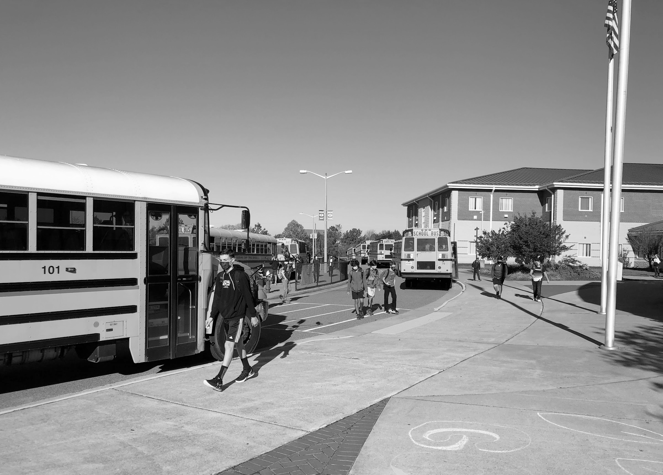


Jeremy J. Raley, Ed.D.
Superintendent
Debbie White, C.P.A.
Chief Financial Officer
goochlandschools.org
jraley@glnd.k12.va.us
dwhite@glnd.k12.va.us
@GoochlandCountySchools
@glndschools

