Slide 1
Tuckahoe Creek Service District
Discussion regarding bond financing

Slide 2
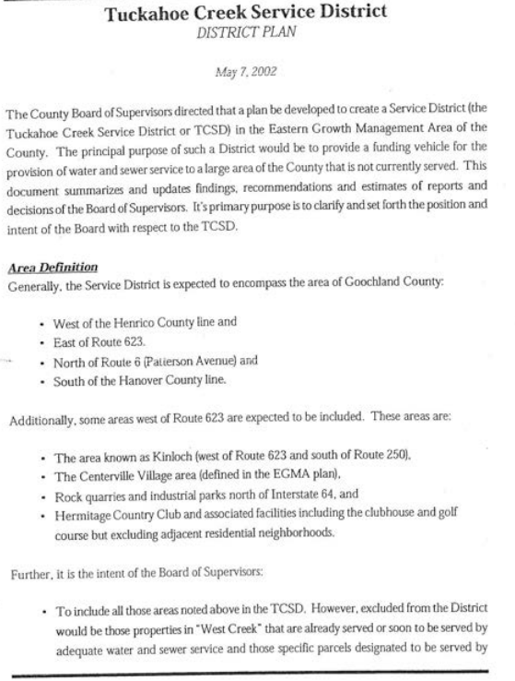

Slide 3
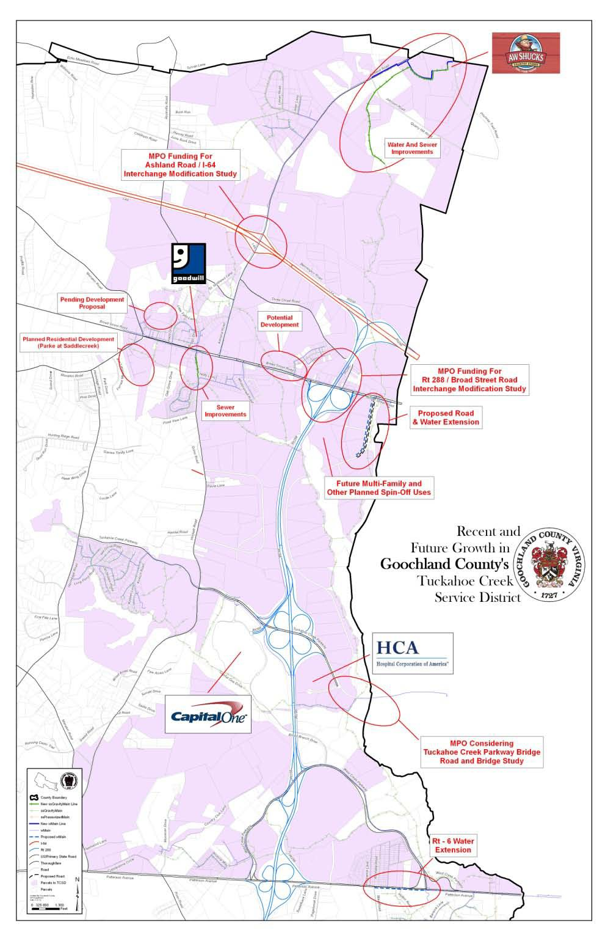

Economic Development
Private and Public Investment Activity is Occurring throughout the District!
Reference Map
Strategic location!!
Things are happening!
6

Slide 4
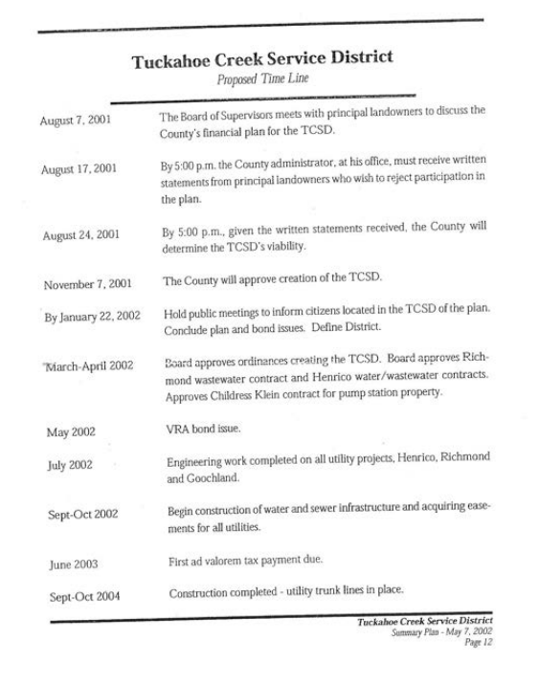

Slide 5


Slide 6
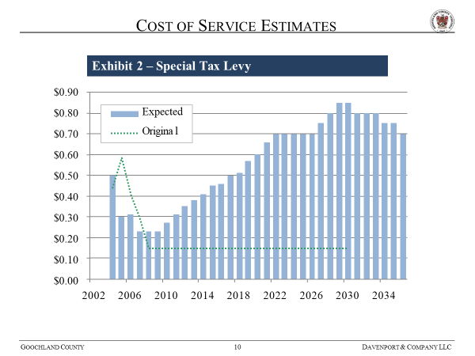

Slide 7
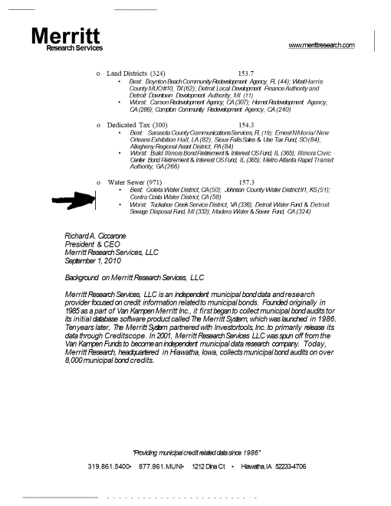

Slide 8
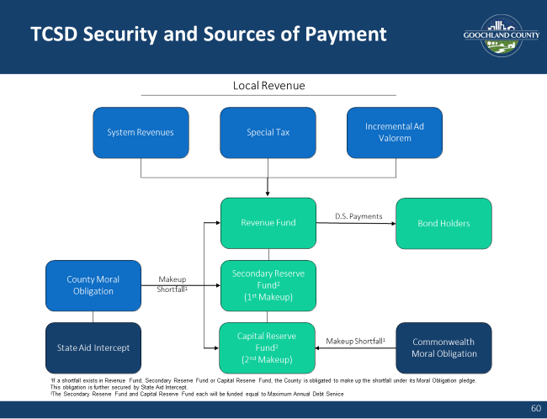

Slide 9
Goochland County
Tuckahoe Creek Service District Initiatives and
Refunding of 2002 Water and Sewer Revenue Bonds
Presentation for the Board of Supervisors and Citizens
September 24, 2012

Slide 10
Refunding Objectives
Stabilize ad valorem tax rate
  Critical for economic development and regional competiveness
  Critical for taxpayers within the district
Lower annual debt service and eliminate debt service peaks
Allow time to grow the tax base and users
Take advantage of historically low interest rate environment
12

Slide 11


Today – The Team
County staff and District 5 Board member Mr. Ken Peterson
New Financial Advisor – Public Financial Management
New Bond Counsel – Kutak Rock
New VRA leadership and staff
New underwriters

Slide 12
Gross Debt Service Comparison
Remaining 2002 Debt Service
Gross Debt Service After Refunding
10
10
9
9
8
8
7
7
Millions of Dollars
6
Millions of Dollars
6
5
5
4
4
3
3
2
2
1
1
0
0
2013 2014 2015 2016 2017 2018 2019 2020 2021 2022 2023 2024 2025 2026 2027 2028 2029 2030 2031 2032 2033 2034 2035 2036
Fiscal Year
Fiscal Year
Non-Callable CABs Callable CABs Callable Term CIB Principal Callable Term CIB Interest VRA Expenses
Non-Callable CABs
Callable CABs
Callable CIB Principal
Callable CIB Interest
VRA Expenses
Existing DS
Outstanding Bond Value at Maturity (2002)
Non-Callable CABs | $ 54,295,000
Callable CABs | $ 28,845,000
Term CIB | $ 32,440,000
Total | $ 115,580,000
Outstanding Bond Value at Maturity (After Refunding)
Non-Callable CABs (2002) | $ 49,505,000
Callable CABs (2012) | $ 38,890,000
Callable CIBs (2012) | $ 27,860,000
Total | $ 116,255,000

Slide 13
Debt Service Savings
2002 Net Debt Service |  | 2012 Net Debt Service | Net Savings
First 10 Years: FY2013-23 | 45,186,421 | 41,020,877 | 4,165,544
Next 13 Years: FY2024-35 | 92,578,832 | 69,975,489 | 22,612,343
Last 6 Years: FY2036-41 | 2,762,490 | 30,419,503 | (27,657,013)
Net Present Value Savings at 3.26%: |  |  | $3,844,952

Slide 14
Proposal Meets Goals
Good for Goochland County:
Smoothes out debt service, eliminates peaks
Provides short term relief
Allows time to grow the tax base and users
Stabilizes outlook for ad valorem tax rate-important to customers in the TCSD and critical for economic development and regional competiveness

Slide 15



Portfolio Risk Management Committee Presentation
September 10, 2012
1111 E. Main Street
Suite 1920
Richmond, VA 23219
804.644.3100
804.644.3109 Fax
www.VirginiaResources.org

Slide 16
Staff Recommendation
Staff recommends approving the restructure of the original loan because a restructure reduces VRA’s and the Commonwealth’s risk and allows all parties to take advantage of the current, favorable interest rate environment.
Staff recommends that the loan not be placed in the VPFP portfolio but move forward on a stand-alone basis, outside of the VPFP due to:
  Ascending debt service structure;
  Significant deviation from VRA’s underwriting guidelines;
  Inherent risk due to the nature of the TCSD project; and
  State aid coverage of the County is inadequate.

Slide 17



Town Hall Meetings March 2013

Slide 18

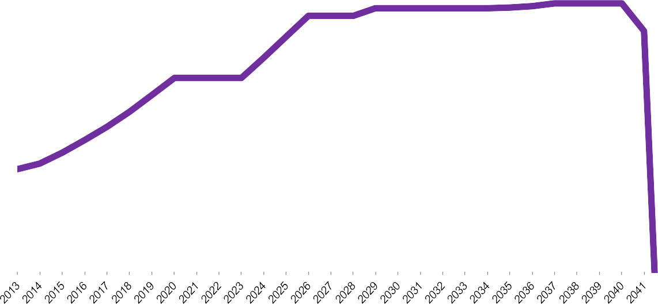
TCSD ad valorem rate remaining $0.32
Due to the Bond Refunding, the Tuckahoe Creek Service District is stable!
Net Debt Service After Refunding
10
9
8
7
Millions of Dollars
6
Previous Max
Debt Service
$8.8 million
5
4
New Maximum Debt Service
$6.2 million
3
Net Present Value Savings
2
$4.4 million
1
0
Fiscal Year
8
Existing DS
Refunding DS

Slide 19
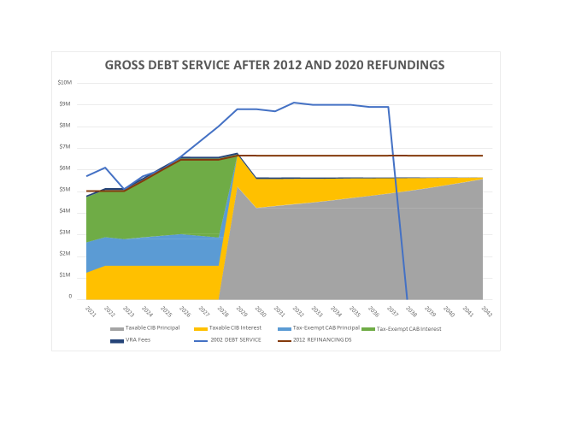

Slide 20

2022 Real Estate Assessments
Report to the Board of Supervisors
February 1, 2022

Slide 21
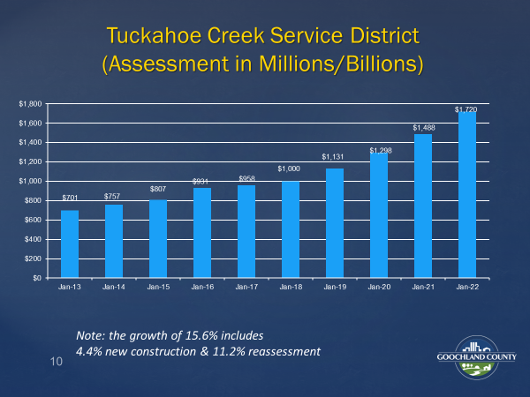

Slide 22
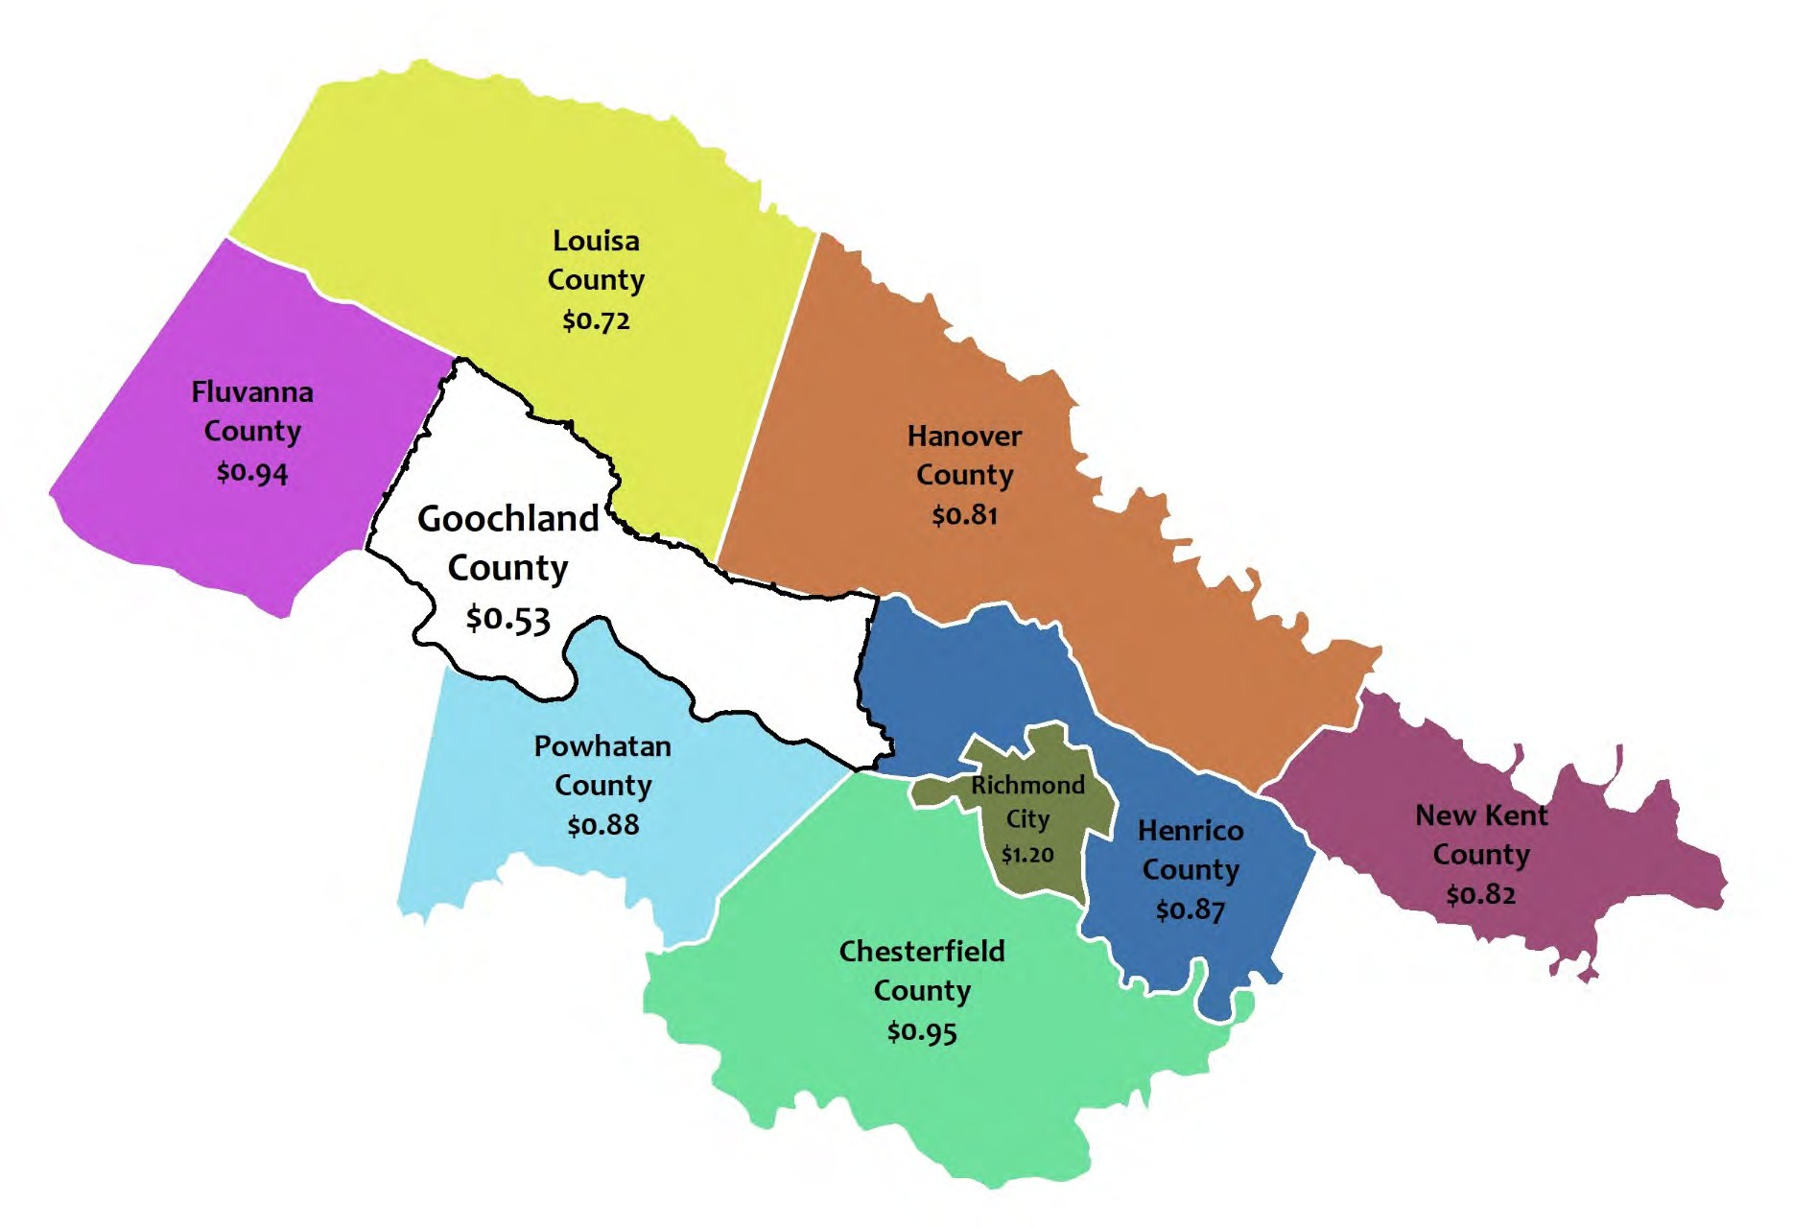
Lowest Tax Rate in Region

Slide 23
Questions?

